Slide 1

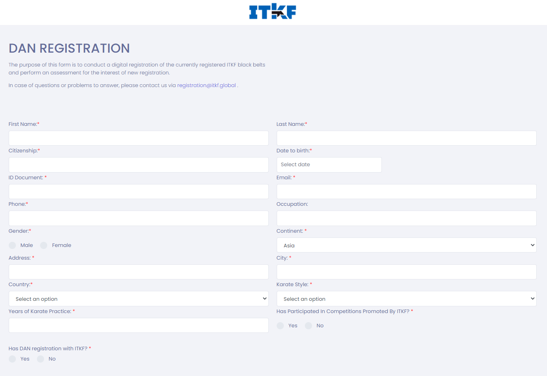

Re-registration information guide
1st Step: Complete your personal data in the form:
  First and Last Name
  Citizenship
  Dat of birth
  Document ID
  E-mail
  Phone
  Occupation
  Gender
  Address
  City
  Country
  Karate Style
  Years of practice

Slide 2
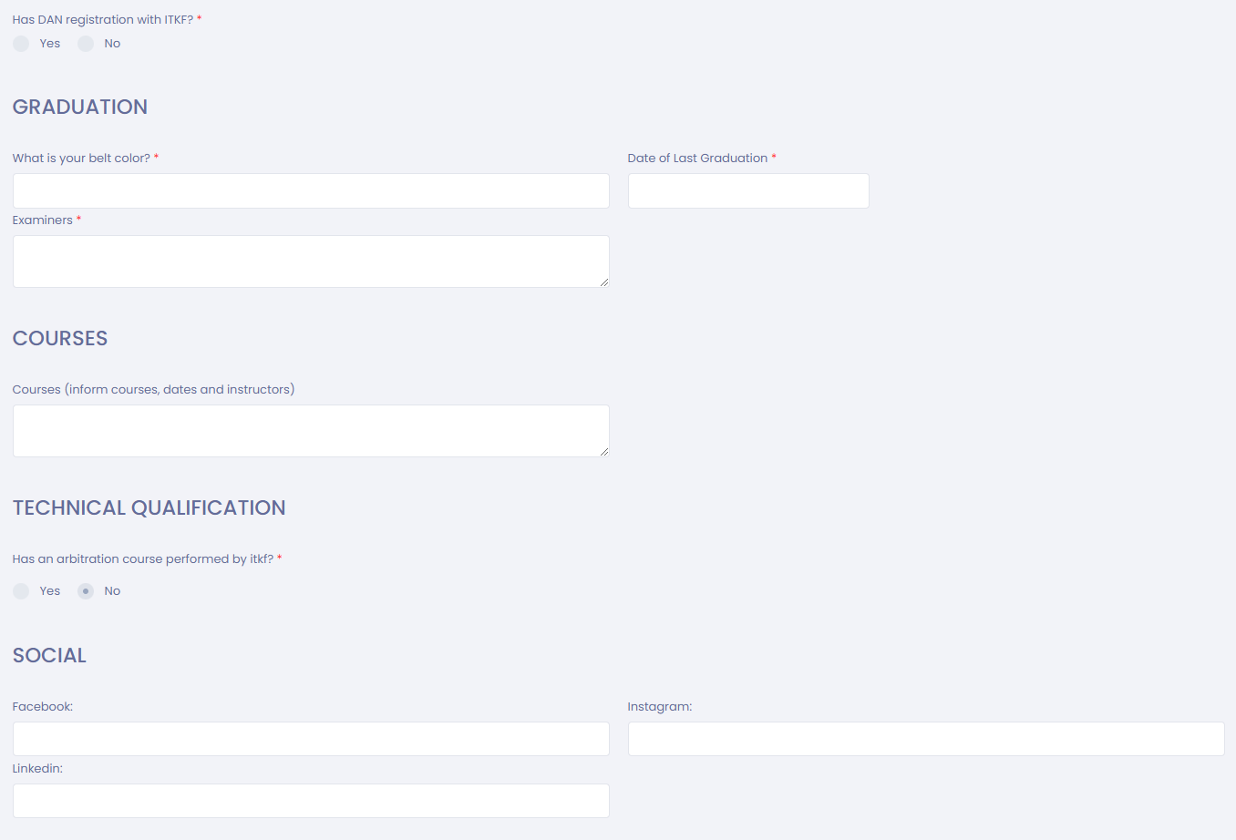
Re-registration information guide
2nd Step: Scroll down and inform data about Graduation
  Current Graduation
  Date of Last Graduation
  Examiners
3rd Step: Scroll down and inform data about Courses and Technical Qualification if any
  Judge Class Kata/Kumite
  Examiner Class
  Coache Class

Slide 3
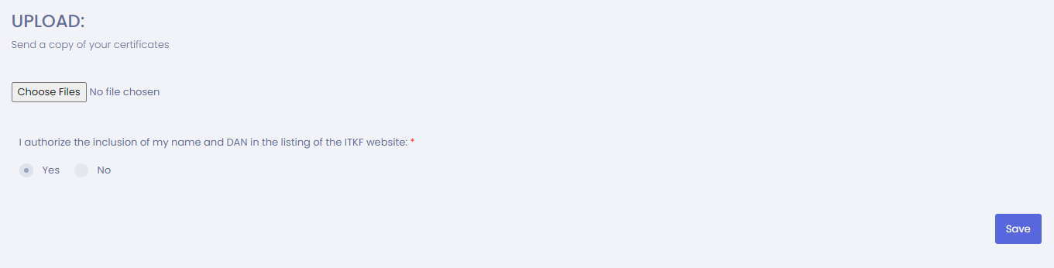
4th Step: Upload copies of your certificates of DAN issued by the National Federation and ITKF if any
5th Step: Inform whether you authorize or not your name to be listed on the ITKF website
6th Step: Click the button Save to submit
Important:
Use the TAB key of the computer to move from field to field
NO NEED TO PRINT or SIGN THE FORM

